Slide 1
Perceptron

Slide 2
CONTENTS
Neural Network | artificial neural network, architecture,
Logistic Regression | simple description to Logistic Regression
Single Layer Perceptron | AND, OR, NAND
Multiple Layer Perceptron | XOR Problem, Back Propagation
Lab
For more info: SLIDESGO | SLIDESGO SCHOOL | FAQs
You can visit our sister projects: FREEPIK | FLATICON | STORYSET | WEPIK | VIDEVO

Slide 3
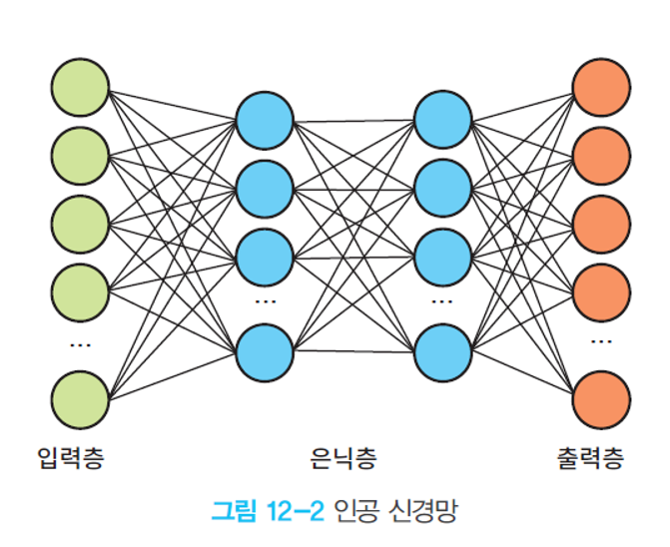
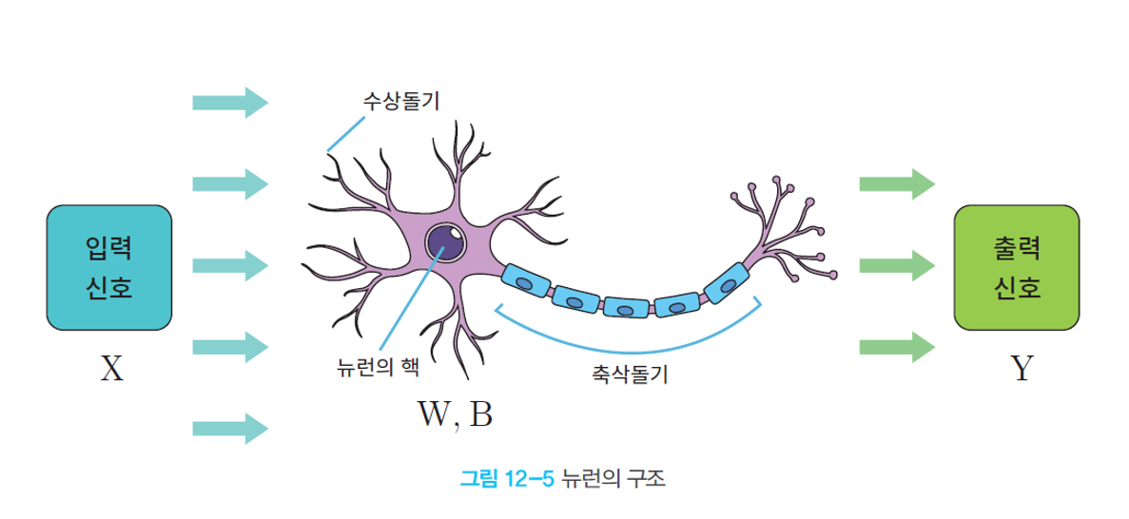
Neural Network
Artificial Neural Network(ANN) is a computing architecture made similar with biological neural network.
Perceptron is an algorithm which gets several input data and results in one output as a unit of ANN.

Slide 4
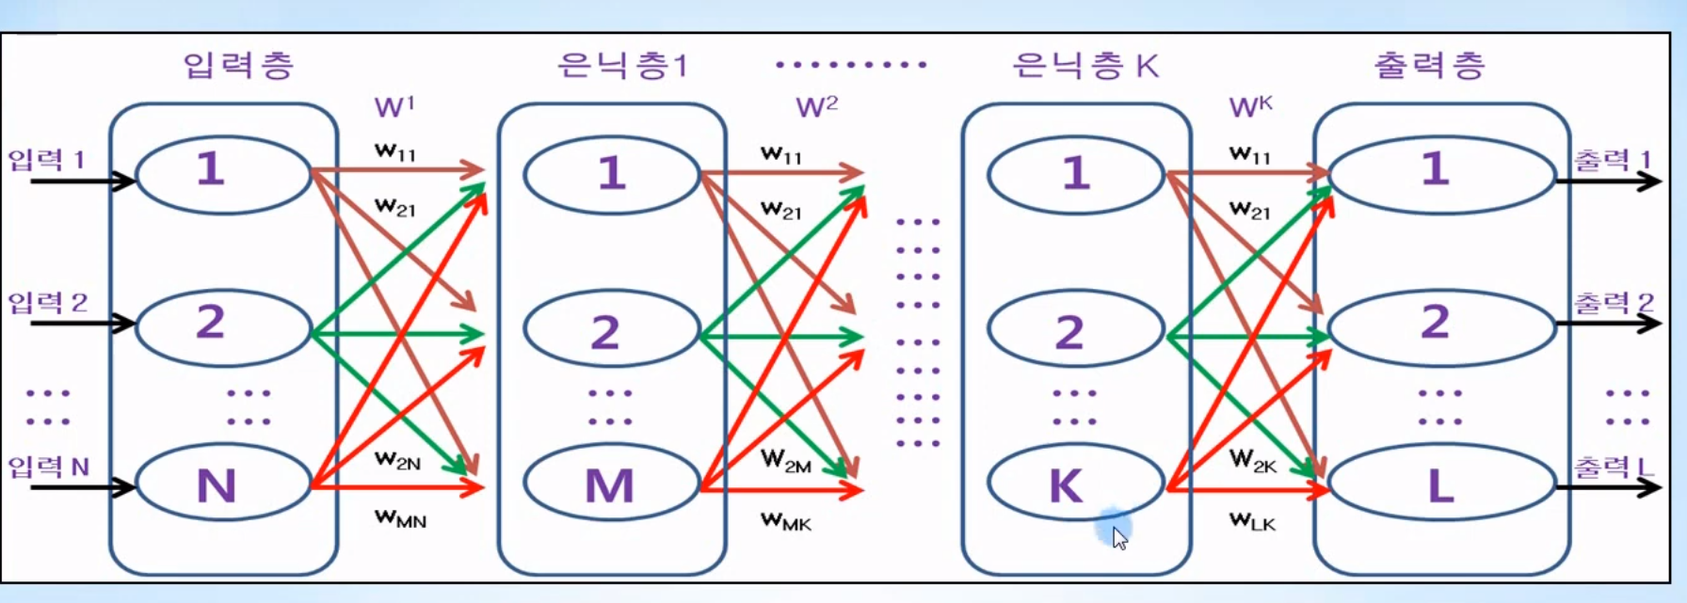
Neural Network
There are three types of layers: input layer, hidden layer, output layer
input layer: a layer which get input data
hidden layer: a layer which does learning
output layer: a layer which output results
: a Node; a logistic regression

Slide 5
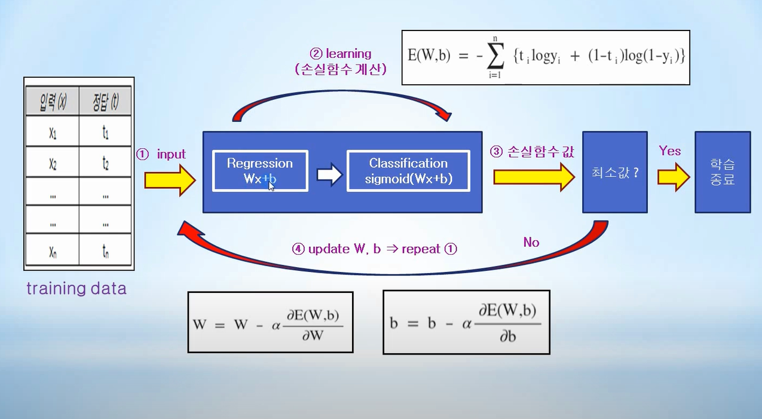
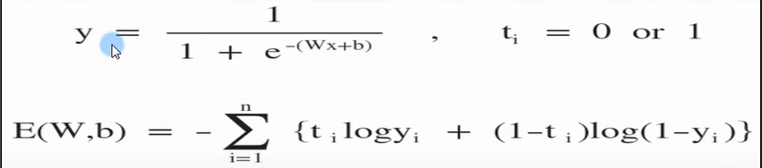
Logistic Regression
Logistic Regression is a classification method which classifies input data into a certain category.

Slide 6
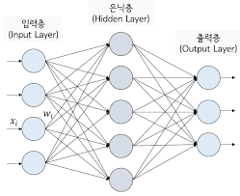
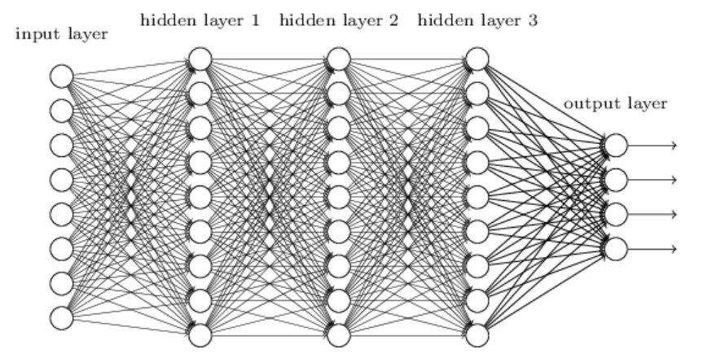
Single Layer Perceptron
Single Layer Perceptron: 1 hidden layer
Multiple Layer Perceptron: more than 1 hidden layer

Slide 7
Single Layer Perceptron
Let's think about AND, OR, NAND logical gate.
x | y | x and y
0 | 0 | 0
0 | 1 | 0
1 | 0 | 0
1 | 1 | 1
x | y | x or y
0 | 0 | 0
0 | 1 | 1
1 | 0 | 1
1 | 1 | 1
x | y | x nand y
0 | 0 | 1
0 | 1 | 1
1 | 0 | 1
1 | 1 | 0
(0,1)
(1,1)
(0,1)
(1,1)
(0,1)
(1,1)
(0,0)
(1,0)
(0,0)
(1,0)
(0,0)
(1,0)

Slide 8
Single Layer Perceptron
Let's make perceptrons for AND, OR, NAND.

Slide 9
Multiple Layer Perceptron
However, in case of XOR, each data can't be classified by a linear.
x | y | x xor y
0 | 0 | 1
0 | 1 | 0
1 | 0 | 0
1 | 1 | 1
(0,1)
(1,1)
(0,0)
(1,0)

Slide 10
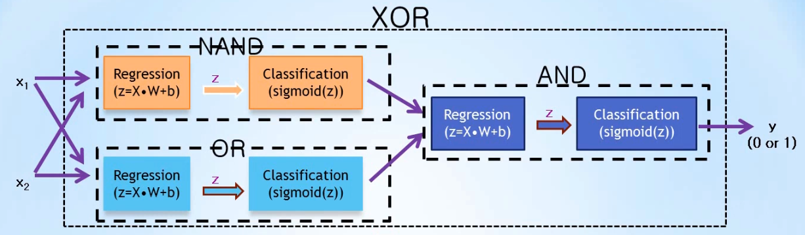
Multiple Layer Perceptron
XOR Problem can be solved with a combination of NAND, OR, and AND Gate.
There are two hidden layers, which means we can solve the XOR Problem with Multiple Layer Perceptron

Slide 11
Multiple Layer Perceptron
So, we can solve complex problems with Multiple Layer Perceptron, which has lots of hidden layers for learning.
The more hidden layers MLP has, the deeper it is; that is, Deep Learning.
Multiple Layer Perceptron: more than 1 hidden layer

Slide 12
Multiple Layer Perceptron
We need to minimize the error between results and answers: Back Propagation
model4.predict(np.array([[0,0],[0,1],[1,0],[1,1]]))

Slide 13
Lab
Let's solve the XOR Problem using MLPClassifier.

Slide 14

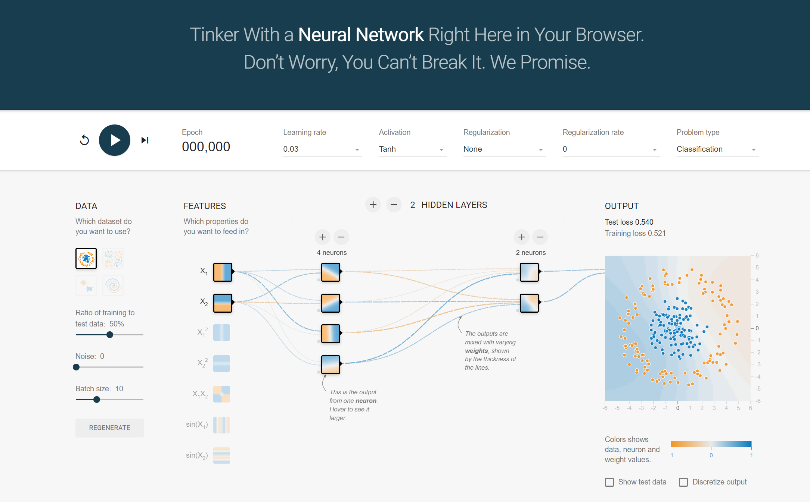
Lab-Neural Network Playground
Let's go to A Neural Network Playground

Slide 15
Lab-Neural Network Playground
Learning start button
learning count
input dataset
Output Layer
Hidden Layer
Input Layer

Slide 16
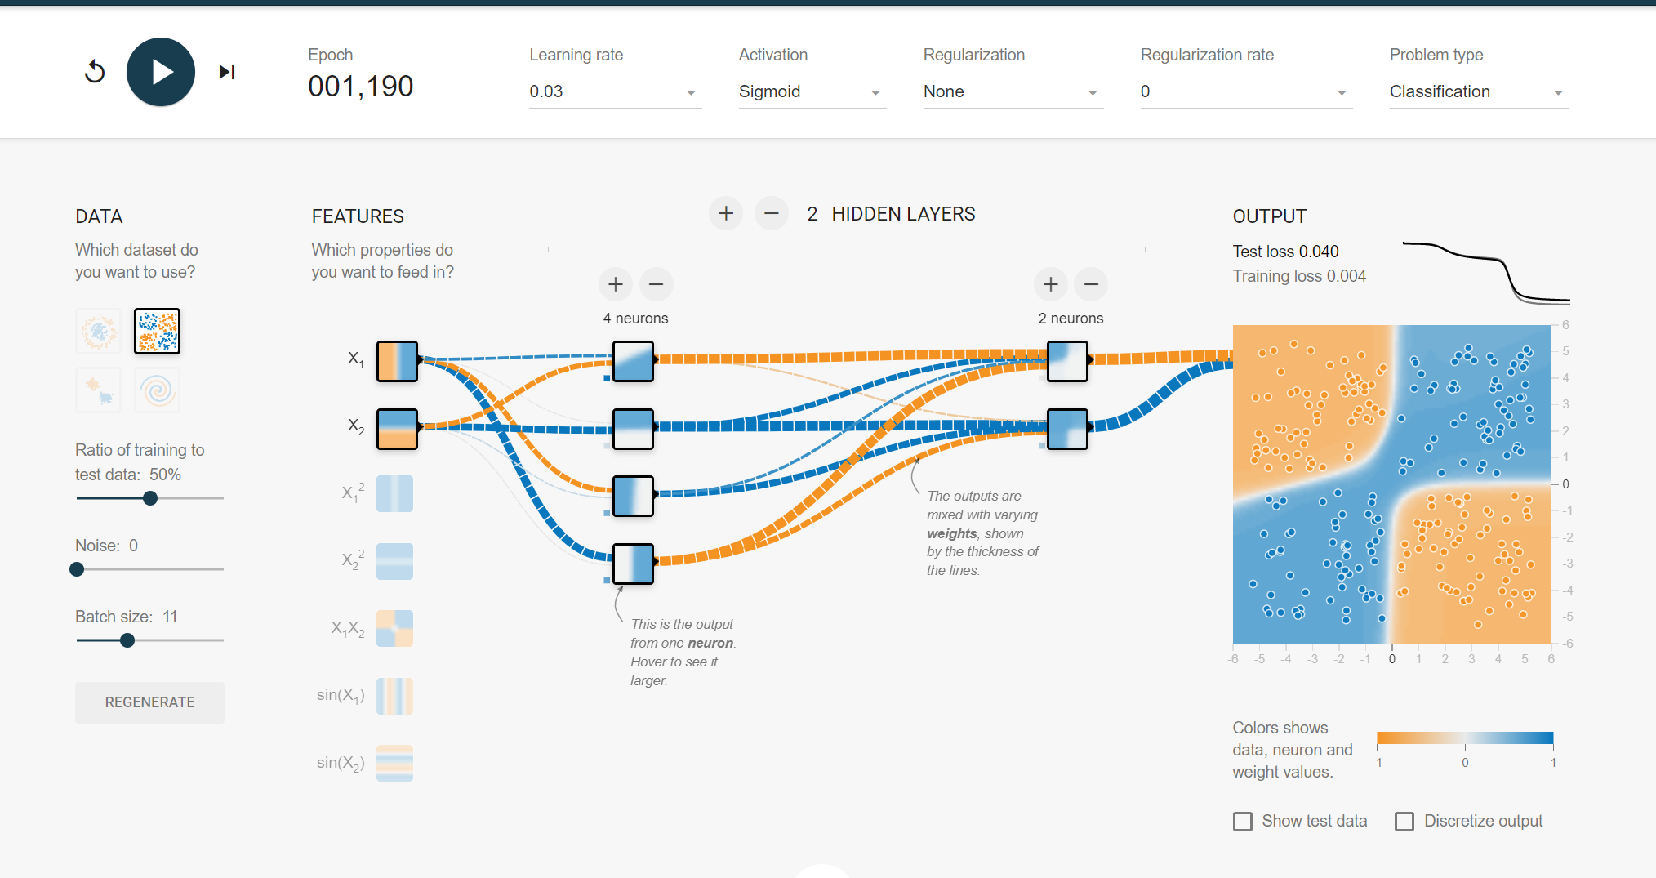
Lab-Neural Network Playground
Visualize how XOR problem is solved

Slide 17
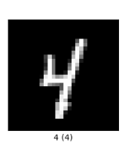
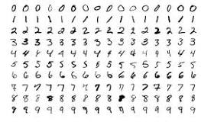
Lab-MNIST dataset
4 !!!

Slide 18
Other datasets
heart disease classification: https://www.kaggle.com/code/cdabakoglu/heart-disease-classifications-machine-learning

Slide 19
THANKS
Do you have any questions?
gurwoghd@gmail.com
Please keep this slide for attribution

